Slide 1
Django

Slide 2
What is Django
Django is a web development framework that assists in building and maintaining quality web applications.
Django helps eliminate repetitive tasks making the development process an easy and time saving experience.
Django is a high-level Python web framework that encourages rapid development and clean, pragmatic design. Django makes it easier to build better web apps quickly and with less code.

Slide 3
Django – Design Philosophies
Loosely Coupled − Django aims to make each element of its stack independent of the others.
Less Coding − Less code so in turn a quick development.
Don't Repeat Yourself (DRY) − Everything should be developed only in exactly one place instead of repeating it again and again.
Fast Development − Django's philosophy is to do all it can to facilitate hyper-fast development.
Clean Design − Django strictly maintains a clean design throughout its own code and makes it easy to follow best web-development practices.

Slide 4
Model View Controller (MVC) :
This Model is the central component of this architecture and manages the data, logic as well as other constraints of the application.
Database – Data, Constraints (PK, FK, Unique Constraints)
The View deals with how the data will be displayed to the user and provides various data representation components.
UI (Search on Amazon)
The Controller manipulates the Model and renders the view by acting as a bridge between both of them.
APIs
Take data from Model
Render in the UI
Heart of MVC
Spring

Slide 5
Model View Template (MVT)
This Model similar to MVC acts as an interface for your data and is basically the logical structure behind the entire web application which is represented by a database such as MySql, PostgreSQL.
The View executes the business logic and interacts with the Model and renders the template. It accepts HTTP request and then return HTTP responses.
The Template is the component which makes MVT different from MVC. Templates act as the presentation layer and are basically the HTML code that renders the data. The content in these files can be either static on dynamic.
Django

Slide 6
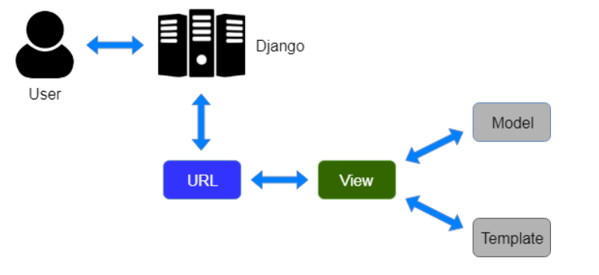
Django MVT

Slide 7
MVC Vs MVT
S/No | MVC | MVT
1 | MVC has controller that drives both Model and View. | MVT has Views for recieving HTTP request and returning HTTP response.
2 | View tells how the user data will be presented. | Templates are used in MVT for that purpose.
3 | In MVC, we have to write all the control specific code. | Controller part is managed by the framework itself.
4 | Highly coupled | Loosely Coupled
5 | Suitable for development of large applications but not for small applications. | Suitable both small and large applications.
6 | Flow is clearly defined thus easy to understand. | Flow is sometimes harder to understand as compared to MVC.
7 | It doesn’t involve mapping of URLs | URL pattern mapping takes place.
8 | Examples are ASP.NET MVC, Spring MVC etc. | Django uses MVT pattern.

Slide 8
Django Features
Rapid Development
Secure
SQL Injections (Because of ORM Mapping)
Corrs Exception
Scalable
Versatile
Open Source
Vast and Supported Community

Slide 9
Advantages
Object-Relational Mapping (ORM) Support − Django provides a bridge between the data model and the database engine, and supports a large set of database systems including MySQL, Oracle, Postgres, etc. Django also supports NoSQL database through Django-nonreal fork. For now, the only NoSQL databases supported are MongoDB and google app engine.
Multilingual Support − Django supports multilingual websites through its built-in internationalization system. So you can develop your website, which would support multiple languages.
Framework Support − Django has built-in support for Ajax, RSS, Caching and various other frameworks.
Administration GUI − Django provides a nice ready-to-use user interface for administrative activities.
Development Environment − Django comes with a lightweight web server to facilitate end-to-end application development and testing.

Slide 10
When to use Django
Django is built to encourage rapid development and clean, practical design.
Like any web application framework, it’s a toolkit of components needed when developing a site.
Its purpose is to provide a concrete foundation of the basics, allowing developers to focus on parts of their site that are unique to their project and not waste time with the fundamental boilerplate stuff.
This is mainly used to develop complicated web application.
Lots of Tables, Lots of constraints, Lots of Templates, Volume of Data is large.

Slide 11
When NOT to use Django
Django is not necessarily the best framework to use in every instance.
While it’s a brilliant foundation for constructing large projects, it’s often overkill for smaller ones.
Its heavy, monolithic structure can be a hindrance for developers looking for highly customizable, quicker apps, such as a short script.
The strengths of Django lay in its reliable, efficient, architecturally sound, secure nature when building apps on the larger side.

Slide 12
Django vs Flask
Admin Interface
The useful admin interface is what makes Django a capable web system. Not at all like Flask, Django incorporates a ready-to-use admin system that empowers clients to carry out the extend organization errands consistently. Based on the venture, it naturally creates admin modules. Engineers can indeed customize the admin interface in arrange to meet the particular trade needs.
Database
Django has bolster for the ORM framework. Advantage of ORM framework includes: Developers can take advantage of the ORM framework to work with an assortment of databases, including PostgreSQL, SQLite, Prophet, MySQL and more. Developers don’t have to type in long SQL inquiries to execute common database operations. Whereas, Flask doesn’t supports the ORM framework. Designers are required to type in SQLAlchemy (Protest Social Mapper and SQL toolkit for Python) in arrange to perform common database operations.
Built-in template engine
Not at all like Django, Flask doesn’t have a built-in layout motor. Flask is based on the Jinja2 format motor. Jinja2 is itself impacted by the Django format motor. Its employments coordinate a sandboxed execution environment, permitting engineers to speed up the advancement handle for energetic web applications. While Django incorporates a built-in format motor that permits engineers to make user-facing layers for web applications consistently and quickly.

Slide 13
Starting With Django
Installations

Slide 14
Todays Objective
Setting up Virtual Environment
Installing Django
Starting the Project
Development Server
Django Apps
VS Code Setup
Create First Website

Slide 15
Creating a virtual environment
Steps to create virtual environment
Install Virtual Env if not installed
Pip install virtualenv
Creation of virtual env
Python2
Virtualenv <environment name>
Python3
Python –m venv <environment name>
Activate the virtual environment
Windows
<environment_name>/scripts/activate
Terminal Base
Source <environment name>/bin/activate
Deactivate the virtual environment once in
deactivate

Slide 16
Install Django and create first Django Project
Activate the virtual environment
Python –m pip install Django
Create first Django project
Django-admin startproject <project name>

Slide 17
The Project Structure
manage.py − This file is kind of your project local django-admin for interacting with your project via command line (start the development server, sync db...). To get a full list of command accessible via manage.py you can use the code −
Python manage.py help
__init__.py − Just for python, treat this folder as package.
settings.py − As the name indicates, your project settings
urls.py − All links of your project and the function to call.
wsgi.py − If you need to deploy your project over WSGI.
asgi.py − If you need to deploy your project over ASGI.

Slide 18
Setting Up Your Project
Database is set in the ‘Database’ dictionary. The example above is for SQLite engine. As stated earlier, Django also supports −
MySQL (django.db.backends.mysql)
PostGreSQL (django.db.backends.postgresql_psycopg2)
Oracle (django.db.backends.oracle) and NoSQL DB
MongoDB (django_mongodb_engine)
You can also set others options like:
TIME_ZONE
LANGUAGE_CODE
TEMPLATE

Slide 19
Run development Server
Use the command
Python manage.py runserver [addrport]
Starts a lightweight development Web server on the local machine. By default, the server runs on port 8000 on the IP address 127.0.0.1. You can pass in an IP address and port number explicitly.
The development server automatically reloads Python code for each request, as needed. You don’t need to restart the server for code changes to take effect. However, some actions like adding files don’t trigger a restart, so you’ll have to restart the server in these cases.
DO NOT USE THIS SERVER IN A PRODUCTION SETTING. It has not gone through security audits or performance tests. (And that’s how it’s gonna stay. We’re in the business of making Web frameworks, not Web servers, so improving this server to be able to handle a production environment is outside the scope of Django.)

Slide 20
Django Apps
Django apps can be considered as modules which basically contribute towards making a whole project.
My Page
Challenges
App1
App2

Slide 21
Django Apps Cont.…
Google
Photos
Maps
Drive
Amazon
Prime
Product
Pay

Slide 22
Apps Cont.…
Create a new app
Python manage.py startapp <app_name>
__init__.py − Just to make sure python handles this folder as a package.
admin.py − This file helps you make the app modifiable in the admin interface.
models.py − This is where all the application models are stored.
views.py − This is where your application views are
tests.py − This is where your unit tests are.
Apps.py – This file is created to help the user include any application configuration for the app. Using this, you can configure some of the attributes of the application.

Slide 23
First Code and Website
URLs
Basic Website Features
Request and Response
Delivering Content

Slide 24
URLs (or routes)
My-page.com/
Show starting page
My-page.com/posts
Show list of all post
My-page.com/posts/specific-post
Show specific post
Routes:
Mapping URLs which ensure certain results are achieved

Slide 25
Views
The logic which are executed for different URLs.
Two types:
Functions
Class
Evaluates request and return responses
Load and prepare data
Run any business logic
Prepare and return response

Slide 26
URLs and Views
Fetching request and processing response is done by view
Request
User
DB
Response
Views are responsible for processing request and returning responses.

Slide 27
Django Models
Creating Models
Model Fields
Migrations
Model Relations
Django Shell (Models)
Create Admin User
Configuring the Admin Interface

Slide 28
Objective
What is Data and Database
Exploring SQL & Model
Models
Database Queries

Slide 29
What is data??
Data : The values we work with in our application.
Temporary Data – Data of Local Variables
Semi – Persistent Data - Cache
Persistent Data – Stored in Database or Flatfiles

Slide 30
Databases
Mainly 2 types
SQL
No SQL
Table Based
Document Based
ID
NAME
AGE
{id:1, name:Jake, age:40},
{id:2, name:Will, age:10}
1
Jake
40
2
Will
10
MySQL, PostGreSQL, SQLite
MongoDB, CassandraDB

Slide 31
Understanding SQL
Create tables and schema
Insert Data to tables
Get the Data
CREATE TABLE books (
Id INTEGER PRIMARY KEY AUTOINCREMENT,
Title VARCHAR(200) NOT NULL,
Rating INTEGER NOT NULL)
INSERT INTO books(Title, Rating)
VALUES (‘Lord of the Rings’. 10)
SELECT * FROM books

Slide 32
Models Feature in Django
Write python code and python class
No need to construct SQL queries
Django will perform the task by itself
Focus on your data and not on the queries
We define data models and run common operations on those data
Django Models translate instructions to SQL queries

Slide 33
Creating a Django Model
We will be working with the models.py file in your app to create Models which are a reflection of your table in the data base
A model can have multiple reference, use the below link to look into the same.
https://docs.djangoproject.com/en/3.2/ref/models/fields/

Slide 34
After model creation how do we reflect them in our Database
Add you apps name mentioned in the <app_name>/apps.py file to the <project_name>/settings file under installed apps
Also need to mention the database details in the settings.py file
INSTALLED_APPS = [
‘<app_name>',
'django.contrib.admin',
'django.contrib.auth',
'django.contrib.contenttypes',
'django.contrib.sessions',
'django.contrib.messages',
'django.contrib.staticfiles',
]
DATABASES = {
'default': {
'ENGINE': 'django.db.backends.sqlite3',
'NAME': BASE_DIR / 'db.sqlite3',
}
}

Slide 35
Let’s create first model Book
Create a model book
Containing below fields
Fields to be added
Title
Rating

Slide 36
Django Migrations
Migrations files are the files which get executed so as to create data in the database.
Command to generate migrations from the models
Python manage.py makemigrations
But tables were still not created yet, how to create the tables
Python manage.py migrate

Slide 37
Insertion of data
Lets play around with the data with Django Shell (Django CLI)
Python manage.py shell
Create a object of Book
Call save method to save the data
<book_object>.save()

Slide 38
Get the data from the database
There is provision in Django to fetch all the data that you have just saved.
Book.objects.all()
Here Objects is a Parent Class which is being inherited
This will return query set

Slide 39
Updating Models
Once you update the models, need to re-run
Perform Makemigrations operation
Then perform migrate
For example
rating = models.IntegerField(validators=[MinLengthValidator(1), MaxLengthValidator(10)])
author = models.CharField(null=True, max_length=100)
is_bestselling = models.BooleanField(default=False)
Note:
We have added validators during the update.
Official Documentation : https://docs.djangoproject.com/en/3.2/ref/validators/#django.core.validators.MinValueValidator
Import statement:
from django.core.validators import MinLengthValidator, MaxLengthValidator

Slide 40
Updating the Database Data
Get the db object from the list of data
Harry_potter = Book.objects.all()[0]
Harry_potter.author = “J.K Rowling”
Harry_potter.is_bestselling = True
Harry_potter.save()

Slide 41
Delete a data
Fetch the object
Call delete
Hp.delete()

Slide 42
Create vs Save
Book.objects.create(title=‘Some’, rating=10, author=‘Some Author’, is_bestselling=False)

Slide 43
Django Relations
Connecting Data & Models
What are Data Relationship
Managing Relations with Django Models

Slide 44
Data is often connected
A book belongs to an author
Books
Authors
An author has written multiple books
One to Many
One author has many books
One book is written by the same author

Slide 45
Types of relationship
One to One
Ex: one author can have one address
One to Many
Ex: 1 Author Many Books, 1 Book Some Author
Many to Many
A book can be published in many countries and a country can have many books.

Slide 46
One to many to our example
Create author Model
Add constraint to Author using below
Author = models.ForiegnKey(author, on_delete=models.CASCADE, null=True)

Slide 47
Save a new Data
Open shell
Create author object
Jkr = Autho(first_name=‘J.K’, last_name=‘Rowling’)
Jkr.save()
Create book object
Harrypotter = Book(title=‘Harry Potter 1’, rating=10, is_bestselling=True, author=jkr)
Harrypotter.save()

Slide 48
Query by related data
Find all books whose last_name = ‘rowling’
books_by_rowling = Book.objects.filter(author__last_name='Rowling’)
Suppose we want to add modifiers for author table in above query
books_by_rowling = Book.objects.filter(author__last_name__contains='ling’)

Slide 49
How to perform a reverse(or inverse)
jkr = Author.objects.get(first_name='J.K’)
Jkr.book_set
Jkr.book_set.all()
On book_set one can perform all the normal operations

Slide 50
Managing Relations in Admin area
Register Author via
Admin.site.register(Author)

Slide 51
One to One Relation
Lets add address for an author
Create Model Address
To add a one to one mapping do the following in Author Model
address = models.OneToOneField(Address)
class Address(models.Model):
street = models.CharField(max_length=100)
postal_code = models.CharField(max_length=6)
city = models.CharField(max_length=50)
def __str__(self):
return "Address : {}, {}, PIN {}".format(self.street, self.city, self.postal_code)

Slide 52
Many to Many Relation
A book can be published in multiple Countries and a Country can have multiple books.
Cannot add on_delete option as Many to Many has 3 tables associated with it
Associate the same with Book using the following
published_countries = models.ManyToManyField(Country)
To add a country to book
book_obj.published_countries.addcountry_obj)
class Country(models.Model):
name = models.CharField(max_length=100)
code = models.CharField(max_length=2)
def __str__(self):
return "{}({})".format(self.name, self.code)

Slide 53
Django Admin Feature
Easy and Powerful Data Administration
Coming from Django.contrib model and Django.contrib app
Admin URL
http://127.0.0.1:8000/admin/login/?next=/admin/
This is not for visitors
This is for owner of the site

Slide 54
Admin: Create SuperUser
Execute the following command
python manage.py createsuperuser
Follow the steps as suggested

Slide 55
Adding our models to Django Admin
Go to <app>/admin.py
Register your model via
Admin.site.register(<Model>)
Restart Server you should be able to see your Model

Slide 56
Configure Model Fields
You can set various validations to the Models which would be reflected on the admin page
Is_blank
Is_Editable

Slide 57
Configure Admin Page
# Register your models here.
class BookAdmin(admin.ModelAdmin):
readonly_fields = ("slug",)
list_filter = ("rating", "author")
list_display = ("title", "author")
admin.site.register(Book, BookAdmin)
Readonly_fields
Prepopulated_fields
List_filter
List_display
Note : Please visit Django Admin Configuration
https://docs.djangoproject.com/en/3.2/ref/contrib/admin/

Slide 58
Querying Data Using get() Function
Book.objects.get(id=<SomeValue>)
Book.objects.get(title=‘<Some Value>’)
Book.objects.get(rating=10)
This gives error because get() function can only get single value and any search result returns multiple value it breaks
Hence, use get only with primary key fields or unique key fields

Slide 59
Querying Data Using filter() function
Book.objects.filter(rating=10)
This will always return a list of data
Can use multiple fields as well
Book.objects.filter(rating=10, is_bestselling=True)

Slide 60
Filtering data based on some conditions <, <=, >, >= etc (Fields LookUps)
Book.objects.filter(rating__gt=7)
Book.objects.filter(rating__gte=7)
Book.objects.filter(rating__lt=7)
Book.objects.filter(rating__lte=7)
Book.objects.filter(author__contains=7)
Note: We can view the filters
Here : https://docs.djangoproject.com/en/3.2/topics/db/queries/

Slide 61
Filtering with Query Sets
Suppose we want to perform filtering based on OR (|), And (,) condition
Django provides us to combine multiple Queries
Ex. find books with (rating<5 OR is_bestselling=True)
Book.objects.filter(Q(rating__lt=5) | Q(is_bestselling=True))
Ex. find books with (rating<5 OR is_bestselling=True) AND (author=‘J.K.Rowling’)
Book.objects.filter(Q(rating__lt=5) | Q(is_bestselling=True)) , Q(author==‘J.K.Rowling’)
OR is marked by | (pipe)
AND is marked by , (comma)

Slide 62
Query Performance
One can initialize a filter to a object
Ex : bestseller = Book.objects.filter(is_bestselling=True)
Upon initialization the database has not yet been hit, it only store query definitions and not the results
Chaining filters is possible
Ex : amazing_bestsellers = bestseller.filter(rating__gt=5)
The data is cached once one fetches the values

Slide 63
Aggregates and ordering
Aggregate examples are
Count
Avg
Min
Max
from django.db.models import Avg, Min, Max
Book.objects.aggregate(Avg(‘rating’))
Book.objects.all().order_by(‘title’)

Slide 64
Views and URLS

Slide 65
Views
A view function, or view for short, is a Python function that takes a Web request and returns a Web response.
Example :
from django.http import HttpResponse
def index(request):
html = "<html><body>My First Django View</body></html>"
return HttpResponse(html)

Slide 66
How Django processes a request
1. Search for the root URLconf module to use specified in ROOT_URLCONF setting
2. Load ROOT_URLCONF module and look for the variable urlpatterns. This should be a sequence of django.urls.path() and/or django.urls.re_path() instances.
3. Django runs through each URL pattern, in order, and stops at the first one that matches the requested URL.
4. Once one of the URL patterns matches, Django imports and calls the given view

Slide 67
Create a sample Monthly Challenge App
Update views.py to create a function which would be called.
Create URLs.py in the app which would then be included in the original

Slide 68
Dynamic Path Segments and Captured Values
Changes to the URLs.py file
Changes to view.py
urlpatterns = [ path("<>", views.monthly_challenge) ] month
from django.shortcuts import render from django.http import HttpResponse, HttpResponseNotFound def monthly_challenge(request, month): challenge_text = None if month == "january": challenge_text = "Do not eat meat" elif month == "february": challenge_text = "Walk for 20 mins" elif month == "march": challenge_text = "Run for 20 mins" else: return HttpResponseNotFound("Month not valid") return HttpResponse(challenge_text)

Slide 69
django.urls.path()
Example : from django.urls import path from . import views
urlpatterns = [
path('posts/', views.post_list),
path('posts/<int:id>/', views.post_detail),
]
To capture a value from the URL, use angle brackets.
<ConverterType:ParameterName>
Default Path Converters :
Int
Str
Slug

Slide 70
Redirection
Use from django.http import HttpResponseRedirect
Use the redirect from domain name
def monthly_challenge_by_number(request, month): months = list(monthly_challenges.keys()) redirect_month = months[month-1] return HttpResponseRedirect("/challenges/" + redirect_month)

Slide 71
Reverse Function and Named URLs
Use the name variable in the Path function mentioned in URL patterns
In views import from Django.urls import reverse
path("<str:month>", views.monthly_challenge, name="month-challenge")
redirect_path = reverse("monthly-challenge", args=[redirect_month]) return HttpResponseRedirect(redirect_path)

Slide 72
Returning HTML Response
Update your monthly_challenge as below
def monthly_challenge(request, month): try: challenge_text = monthly_challenges[month] response_data = "<h1>{}</h1>".format(challenge_text) return HttpResponse(response_data) except: return HttpResponseNotFound("<h1 style='color:red'>Month Not found</h1>")

Slide 73
Django Templates

Slide 74
Templates
Standalone HTML files
Need to be dynamic so that data could be populated
This then can be rendered so that an HTML page is created
Understanding Templates
Django Template Language Features (DLT)
Working with Static files (CSS, JAVA Scripts, Images)

Slide 75
Adding and Registering Templates
Folder Structure is represented as
Templates
<App_Name>
.HTML files
To configure your templates go to settings.py file
Update the DIRS key in the templates variable
This value should be the absolute path to the template folder
BASE_DIR + “/challenges” + “/templates”

Slide 76
Adding and Registering Templates
But there is a better way to specify our templates locations
APP_DIR : true
Just add your app name to the list of INSTALLED_APPS
So Django would look for the templates folder in your application.

Slide 77
Rendering Templates
Why do we repeat the app name in the templates folder
Django essentially merges all the templates data to a big template folder which it later uses.
So as not to confuse Django always place your templates under template/<app_name> folder

Slide 78
Adding Dynamic Code (Django Template Language DTL)
Enhances HTML files to create dynamic pages
Standard HTML Syntax
Special DTL syntax
Dynamic HTML Page

Slide 79
Variable Interpolation
For rendering now we will be using render function in the view
Return render(request, “challenges/challenge.html”)
You can also send value from the views.py to the template which would be parsed via DTL
And in the template to display the text variable use:
return render(request, "challenges/challenge.html", { "text": challenge_text })
<!DOCTYPE html> <html lang="en"> <head> <meta charset="UTF-8"> <title>Monthly Challenge</title> </head> <body> <h1>This is a monthly challenge</h1> <h2>{{ text }}</h2> </body> </html>

Slide 80
Filters
Perform formatting on templates only
Visit https://docs.djangoproject.com/en/3.2/ref/templates/builtins/
Formatting that can be applied to so some simple formatting
This are part of the DTL

Slide 81
Tags
All tags are created within {% %}
Ex lets create a for tag to iterate through months
{% for month in months %}
<li>{{ month|title }}</li>
{% endfor %}

Slide 82
URL tags for dynamic URLs
Lets populate the href in the previous example
Lets use the URL tag which is essentially a reverse function
{% url 'monthly-challenge' month=month %}

Slide 83
If Tag
Add if tag for conditional evaluation
Example we update challenge.html as below
{% if challenge in not None %} <h2>{{ challenge }}</h2> {% else %} <p>The is no challenge set for this yet</p> {% endif %}

Slide 84
Template Inheritance and block Tag
We have a similar data between index.html and challenge.html
The core template is same.
Lets create a template folder in your project
Create a base.html file
<!DOCTYPE html> <html lang="en"> <head> <meta charset="UTF-8"> <title>{% block page_title %}My Challenges{% endblock %}</title> </head> <body> {% block content %} {% endblock %} </body> </html>

Slide 85
Extends Tag
Extends will enable one to extend/inherit another template
For example in index.html
{% extends "base.html" %} {% block page_title %} All Challenges {% endblock %} {% block content %} <ul> {% for month in months %} <li><a href="{% url 'monthly-challenge' month=month %}">{{ month|title }}</a></li> {% endfor %} </ul> {% endblock content %}

Slide 86
Partial Templates and Static Files
Partial Templates
Static Files
Configuring Static Files
Serving Static File in Development
Handling 404 Responses

Slide 87
Partial Template Snippet and include tag
Generate common HTML snippets that can be used by the templates
{% include ‘templatename’%}
To send variables across use the following
{% include ‘template name’ with variable_name=‘Data’ %}

Slide 88
404 Templates
For this cannot use render shortcut as that always returns the successful messages.
Http404 Class
We need to raise the error Class
Raise Http404()
This would look for 404.html page

Slide 89
Manage Static Files
Basically not manipulated by server
The content is not changed by the server
Eg: CSS, JS etc
Create static folder
Create folder named app

Slide 90
Configure static files
Check for Django.contrib.staticfiles in INSTALLED_APPS in settings.py, it should be there by default
Load static files
{% load static %}
Load(re-run) the application after adding static files
Static files are generally picked up by Django from app folder
To give a path to a new/common static do the following in settins.py
STATICFILES_DIRS = [ BASE_DIR / "static" ]

Slide 91
Blog : Assignment

Slide 92
Steps
Create Blog Website (name the project as per your discretion)
Create the below mentioned views
starting_page : This will be the index page, which shall display the latest post
posts : Display all the posts, which shall display all the post
post_detail : Display the content for a given post, which shall display a given post, search by slug (Eg : lets-learn-Django for title Lets Learn Django)
URLs Mapping should be mentioned as below
127.0.0.1:8000/ -> view.starting_page
127.0.0.1:8000/posts -> view.posts
127.0.0.1:8000/posts/<slug:slug> -> view.post_detail

Slide 93
Design
Index Page:
Should contain a header with links to the index page and all posts
Should contain the latest 3 blogs/posts with name, summary, date
Add an about us section
All Posts Page:
Should contain a header with links to the index page and all posts
Should contain a list of all the post with the following value
Should contain the name, summary, date
Each post name should be a link clicking on which you should be redirected to the specific post page
Specific Post Page:
Should contain a header with links to the index page and all posts
Should display all the details
Name
Content
Date

Slide 94
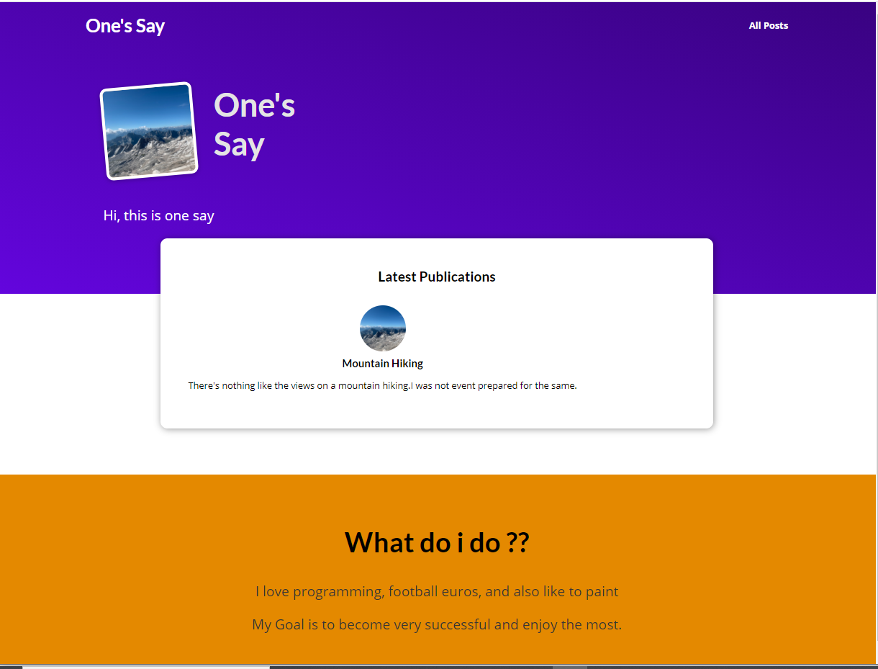
Sample Images

Slide 95
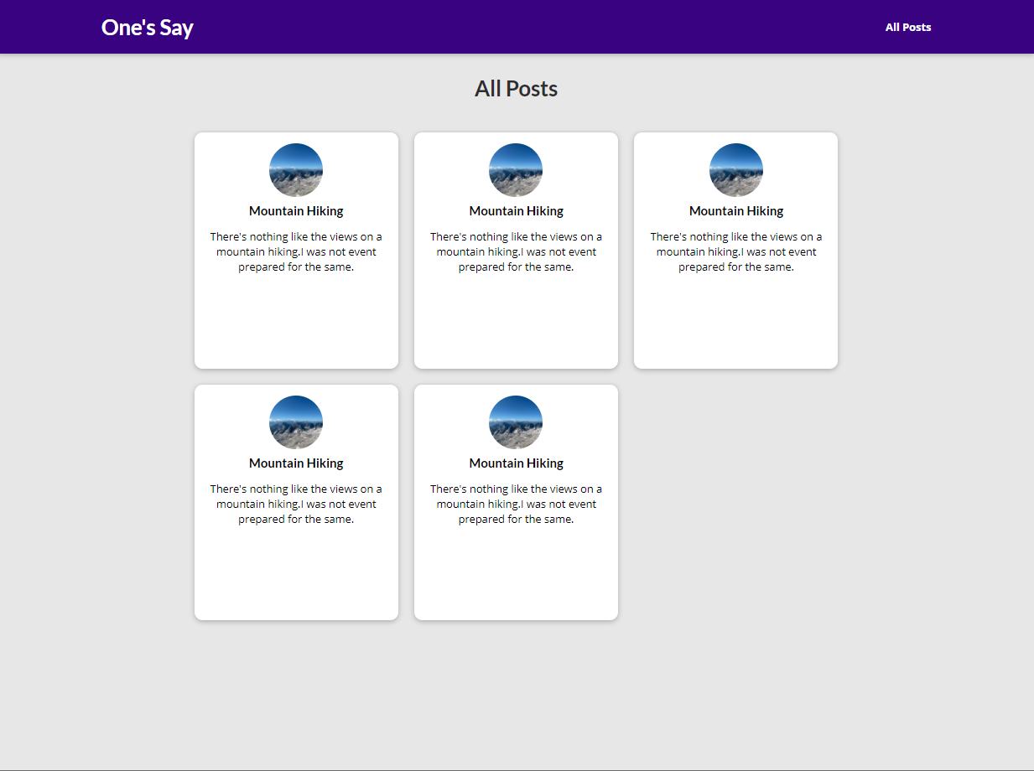
Sample All Post Page

Slide 96
User Inputs, Forms, Class Based Views
User Inputs
Forms

Slide 97
Content
Creating and Handling Forms
Simplify Form Management

Slide 98
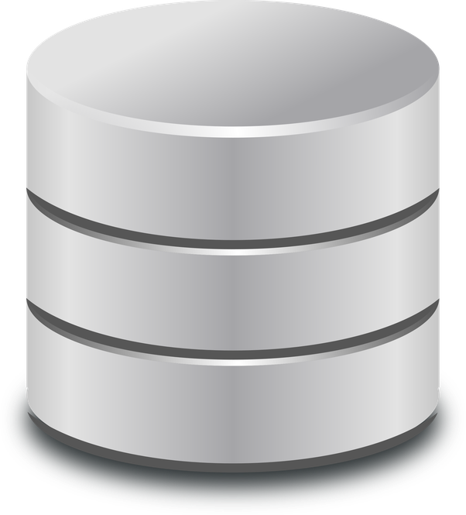
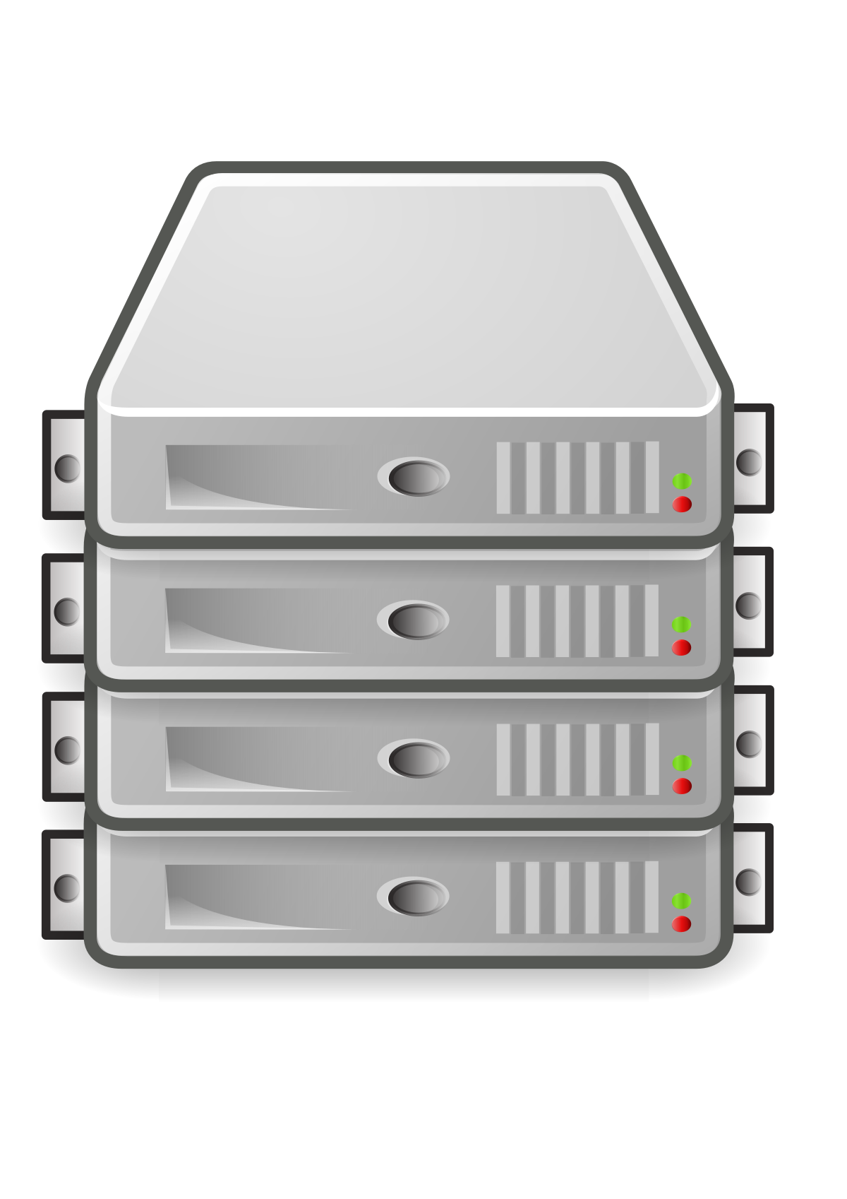

Get and Post Methods
Request
Server (Back-end)
Client Front End
Response
Request Could be either Get or Post
Get : Meaning we want some data from server
Post: Meaning submit some data to the server

Slide 99
Get vs Post
Get | Post
Used to get some data | Used for submitting data to server
Get uses query parameters, which than can be used to get the information | Generally sends data via some Mediatype like JSON, XML, Multi media etc.
Ex : /get/department?dept=id | Ex: we will send data to server via { dept=‘id’, name=‘name’ }
Cannot carry data | Can carry data

Slide 100
CSRF Protection
Cross Site Request Forgery
<!DOCTYPE html> <html lang="en"> <head> <meta charset="UTF-8"> <title>Add Review</title> </head> <body> <form method="post"> {% csrf_token %} <label for="username">Your Name : </label> <input id="username" name="username" type="text" > <button type="submit">Send</button> </form> </body> </html>

Slide 101
Handle Form Submission and Extracting Data
Form submission can be handled either within the same page or it can be redirected to a different page
Action can specify the page that we want to go if not specified will be directed to the same page
We get same post and get in the same function
<form method="post" action="/">

Slide 102
How to get the data in View
Use the method variable
POST will return everything in dictionary
Request.POST[‘username’]
To return data back always use the Get Function as post is used to submit data
if request.method == 'POST': pass
from django.shortcuts import render from django.http import HttpResponseRedirect # Create your views here. def review(request): if request.method == 'POST': user_name = request.POST['username'] print(user_name) return HttpResponseRedirect("/thank-you") return render(request, "reviews/review.html") def thank_you(request): return render(request, "reviews/thank_you.html")

Slide 103
Using Django Form Class
Create Forms.py
Similar to Models.py
Import the form in your view.py
Send the form object to the template
This will generate the HTML data automatically
from django import forms class ReviewForm(forms.Form): user_name = forms.CharField() password = forms.CharField()

Slide 104
Validate using Forms
Is_valid() function:
Will perform 3 task
Validate form like looks for empty etc
Return TRUE of form is valid
If is valid then it will populate another field with that data

Slide 105
Customizing Form Control
Example
Max_length
Maximum length that is allowed
Label
class ReviewForm(forms.Form):
username = forms.CharField(label="Your Name")
password = forms.CharField()
Note : Please check for various values for a field https://docs.djangoproject.com/en/3.2/ref/forms/fields/

Slide 106
Customize HTML of Django Forms
You can specify the various tags that you need to be displayed
You can add styling to the same please import any css and check if the styling are taking place
<form method="post" action="/"> {% csrf_token %} {{ form.username.label_tag }} {{ form.username }} {{ form.username.errors }} <button type="submit">Send</button> </form>

Slide 107
Adding multiple fields
{% load static %}
<!DOCTYPE html>
<html lang="en">
<head>
<meta charset="UTF-8">
<title>Add Review</title>
<link rel="stylesheet" href="{% static 'reviews/style.css' %}"/>
</head>
<body>
<form method="post" action="/">
{% csrf_token %}
{% for field in form%}
<div class="form-control {% if field.errors %}errors{% endif %}">
{{ field.label_tag }}
{{ field }}
{{ field.errors }}
</div>
{% endfor %}
</form>
</body>
</html>
Adding multiple field and displaying the same
class ReviewForm(forms.Form): username = forms.CharField(label="Your Name", max_length=100, error_messages={ "required": "Please enter name", "max_length": "Length cannot exceed 100 letter" }) review_text = forms.CharField(label="Your Feedback", widget=forms.Textarea, max_length=500) rating = forms.IntegerField(label='Your Rating', min_value=0, max_value=10)

Slide 108
Storing data to database
Create review Models
And from views class save the data to the database
from django.db import models from django.core.validators import MinValueValidator, MaxValueValidator # Create your models here. class Review(models.Model): user_name = models.CharField(max_length=100) review_text = models.TextField(max_length=200) rating = models.IntegerField(validators=[MinValueValidator(0), MaxValueValidator(10)])
from django.shortcuts import render from django.http import HttpResponseRedirect from .forms import ReviewForm from .models import Review # Create your views here. def review(request): if request.method == 'POST': form = ReviewForm(request.POST) if form.is_valid(): review_model = Review(user_name=form.cleaned_data['username'], review_text=form.cleaned_data['review_text'], rating=form.cleaned_data['rating']) review_model.save() return HttpResponseRedirect("/thank-you") else: form = ReviewForm() return render(request, "reviews/review.html", { "form": form }) def thank_you(request): return render(request, "reviews/thank_you.html")

Slide 109
Introduction to ModelForms
Model Forms enable you to create a form by using the model itself
It has all the properties of a Form but will be rendered using Models
class ReviewForm(forms.ModelForm): class Meta: model = Review fields = ['user_name', 'review_text', 'rating'] # __all__, for excluding use excludes

Slide 110
Configuring ModelForms
Can customize labels error messages etc
class ReviewForm(forms.ModelForm): class Meta: model = Review fields = ['user_name', 'review_text', 'rating'] # __all__, for excluding use excludes labels = { "user_name": "Your Name", "review_text": "Your Feedback", "rating": "Your Rating" } error_messages = { "user_name": { "required": "Please enter name", "max_length": "Length <100" } }

Slide 111
Class Based Views
View
TemplateView
ListView
DetailsView
FormView
CreateView

Slide 112
Create View Class
Class-based view allows you to respond to different HTTP request methods with different class instance methods, instead of with conditionally branching code inside a single view function.
In views.py import
from django.views import View
https://docs.djangoproject.com/en/3.2/topics/class-based-views/

Slide 113
Class Based View Example
from django.views import View # Create your views here. class ReviewView(View): def get(self, request): form = ReviewForm() return render(request, "reviews/review.html", { "form": form }) def post(self, request): form = ReviewForm(request.POST) if form.is_valid(): form.save() return HttpResponseRedirect("/thank-you"); return render(request, "reviews/review.html", { "form": form })
as_view () : Django’s URL resolver expects to send the request and associated arguments to a callable function, not a class, class-based views have an as_view() class method which returns a function that can be called when a request arrives for a URL
Updates in urls.py
from django.urls import path from . import views urlpatterns = [ path("", views.ReviewView.as_view()), path("thank-you", views.ThankYouView.as_view()), ]

Slide 114
Various HTTP Methods Supported
get
post
put
patch
delete
head
options

Slide 115
Various Generic Views
Template Views
List & Detail Views
Form View
Create/Update/Delete View

Slide 116
Template View (Get Some Info)
Create views that specifically render templates
Import statement : from django.views.generic.base import TemplateView
How to perform variable interpolaration
Overwrite get_context_data
class ThankYouView(TemplateView): template_name = "reviews/thank_you.html"
def get_context_data(self, **kwargs): context = super().get_context_data(**kwargs) context["message"] = "This Works !!" return context

Slide 117
Create a view to get and display all the reviews
Create a template review_list.html
Create a template ReviewListView extend Template View
Get all the content and send it via a context
{% extends 'reviews/base.html' %} {% block title %} All Reviews {% endblock %} {% block content %} <ul> {% for review in reviews %} <li> {{ review.user_name }} (Rating : {{ review.rating }}) </li> {% endfor %} </ul> {% endblock %}
class ReviewListView(TemplateView): template_name = "reviews/review_list.html" def get_context_data(self, **kwargs): context = super().get_context_data(**kwargs) reviews = Review.objects.all() context['reviews'] = reviews return context

Slide 118
Display a given review
Create a review SingleReviewView in the view.py
Create a template single-review.html
{% extends 'reviews/base.html' %} {% block title %} Review Detail {% endblock %} {% block content %} <h1>{{ review.user_name }}</h1> <p>Rating : {{ review.rating }}</p> <p> {{ review.review_text|linebreaks }} </p> {% endblock %}
class SingleReviewView(TemplateView): template_name = "reviews/single_review.html" def get_context_data(self, **kwargs): context = super().get_context_data(**kwargs) request_id = kwargs["id"] selected_review = Review.objects.get(pk=request_id) context["review"] = selected_review return context

Slide 119
ListView
Display a list of data as we have done in the ReviewListView Class
Import statement : from django.views.generic import ListView
This will send a object_list variable to the template containing all the data
Explicitly used when you want to fetch some data from models
class ReviewListView(ListView): template_name = "reviews/review_list.html" model = Review
class ReviewListView(ListView): template_name = "reviews/review_list.html" model = Review context_object_name = "reviews"

Slide 120
DetailView
Can be used to load a single data from your model
Import statement : from django.views.generic import DetailView
It loads the data based on primary key or a Slug
This is defined by us on the URL (either a PK or a Slug)
To access the exposed data you can use the object or model name in all lower case in the template
Explicitly used when you want to fetch some data from models
class SingleReviewView(DetailView): template_name = "reviews/single_review.html" model = Review

Slide 121
When to use which Views
The extra classes defined are just helper so that you can reduce few lines.
One may create all the views from the bottom up.
It’s a personal preference
Also sometime depends on the use case
ThankYouView does not interacts with the database and hence you cannot use ListView or DetailView
If you want to handle both get and post request then go for View

Slide 122
Form View
This is essentially used to perform a get and as well as perform a POST
All previous views were used for fetching or getting the data
Import statement: from django.views.generic.edit import FormView
class ReviewView(FormView): form_class = ReviewForm template_name = "reviews/review.html" success_url = "/thank-you" def form_valid(self, form): form.save() return super().form_valid(form)

Slide 123
Create View
Specialized FormView which can be used to create data
This will again can be used only when you are interacting with models
Here you can configure the fields directly that is required to create the data as we have done in the ModelForm (ReviewForm)
Import statement: from django.views.generic.edit import CreateView
class ReviewView(CreateView): form_class = ReviewForm model = Review template_name = "reviews/review.html" success_url = "/thank-you"

Slide 124
Blog Add Database

Slide 125
Models
Author
Post
Tag
First Name
Last Name
Email Address
Title
Summary
Image_Name
Date
Slug
Content
Caption

Slide 126
Assignment 3 Tasks
Create and Migrate all the models
Add models to Admin Site
Update Blogs to Fetch Recent 2 From DB
Update Blogs to fetch all the post from DB
Update Blogs to fetch particular post based on slug from DB
Convert all function based views to class based views (Use appropriate views)
Create Comment Form and add reference of the same to post_details page
Save Comments from Form to DB for a particular post

Slide 127
Sessions

Slide 128
What are sessions
An “ongoing connection” between a client and the server.
Can be clear, deleted or reset
Data stored in session persists as long as the session is active (TTL).
Client
Server
Cookie with Session Data
Session data + identifier
Stored in DB

Slide 129
How to enable session
Please ensure that this is available in MIDDLEWARE
django.contrib.sessions.middleware.SessionMiddleware
Also check the below in INSTALLED_APPS
django.contrib.sessions
To define how long the session should be active
SESSION_COOKIE_AGE (in seconds)

Slide 130
Update the reviews project
Add a button to single review template
Wrap the same around form
Send the data via input type = hidden
Create a new URL
Create a view to handle post

Slide 131
Storing Data to Session
The request object already contains the session object we can add out data to it
The data you save in sessions is converted to json and hence should be convertible to JSON (serializable)
class AddFavorite(View): def post(self, request): review_id = request.POST["review_id"] fav_review = Review.objects.get(pk=review_id) request.session["favorite_review"] = fav_review url = reverse("selected-review", args=review_id) return HttpResponseRedirect(url)

Slide 132
Fetch Session Data
You can fetch the data from request.session in two ways
Request.session[‘session_key’]
Request.session.get(‘session_key’)
class SingleReviewView(DetailView): template_name = "reviews/single_review.html" model = Review def get_context_data(self, **kwargs): context = super().get_context_data(**kwargs) loaded_review = self.object request = self.request fav_id = request.session.get('favorite_review') context["is_favorite"] = fav_id == str(loaded_review.id) return context

Slide 133
File Uploads

Slide 136
Django Rest Framework

Slide 137
View in Rest
Rest framework provides an APIView class, which subclasses Django's View class.
APIView classes are different from regular View classes in the following ways:
Requests passed to the handler methods will be REST framework's Request instances, not Django's HttpRequest instances.
Handler methods may return REST framework's Response, instead of Django's HttpResponse. The view will manage content negotiation and setting the correct renderer on the response.
Any APIException exceptions will be caught and mediated into appropriate responses.
Incoming requests will be authenticated and appropriate permission and/or throttle checks will be run before dispatching the request to the handler method.

Slide 139
Authentication
https://www.django-rest-framework.org/api-guide/authentication/

Slide 140
Various Authentication
Basic
Session
Token
OAuth

Slide 141
Session and Basic
from rest_framework.authentication import BasicAuthentication, SessionAuthentication
from rest_framework.permissions import IsAuthenticated

Slide 143
Deployment
From Development to Deployment

Slide 144
Deployment Considerations
Choose Database
(reconsider SQLite)
SQLite works for most of the cases but could be too slow or could be erased
Adjust Settings
Adjust Settings for chosen hosting provider, remove development settings
Collect Static Files
Static files do NOT get serve automatically (as they can be served only in dev server)
Handle Static & Uploaded Files Serving
Static files do NOT get serve automatically (as they can be served only in dev server)
Choose host & deploy
Host Specific docs

Slide 145
Choose Database
Need to decide between SQL and NoSQL
SQL
NoSQL
Prefer SQL because Django model system supports it flawlessly
SQLite
MySQL
Postgres

Slide 146
Web Server
Django is NOT a web server
Django is a framework for Python
It knows how to work with incoming request and generate response
It does NOT listen for incoming requests or handle any other server task
Hence, we need a dedicated webserver where wsgi.py and asgi.py files gets important
Deploying Django

Slide 147
Static Files & User Uploads
Does NOT server static or uploaded files automatically
During development we used runserver which served the purpose
Configure Django to serve such files in urls.py
Configure Webserver to server static files and Django App
Use dedicated server for static and upload files
Okay for smaller sites, not performance-optimized
Same server and device but separate processes
Initial setup is complex but best performance

Slide 148
Choosing a hosting provider
Digital Ocean (Link Here)
AWS (Link Here)

Slide 149
What data should we keep in settings
Keep the SECRET_KEY in a secret
AWS Secrets
Environment Variables
Update the property DEBUG
DEBUG = False
The ALLOWED_HOSTS variable
ROOT_URLCONF – DONOT change this

Slide 150
Setting.py for collecting static files
STATICFILES_DIRS : Location of all the static files
For Development it serves them
For Prod : able to collect them
Collect all the static files from all apps and move to one folder
Create STATIC_ROOT variable and provide the path to collect all static files
STATIC_URL -> should be available
DONOT keep the path of MEDIA_ROOT and STATIC_ROOT same because of security issues
After defining STATIC_ROOT run the below command
Python manage.py collectstatic

Slide 151
Serving static files
Serve them from Django
Add static to the URLS.py
Static(settings.STATIC_URL, document_root = settings.STATIC_ROOT)
Serve from webserver
Update configuration in w.r.t to you hosting server which then can be used

Slide 152
Environment Variables
Variables which are generally defined on system which we can then use
Generally we would like some values to be fetched from the Environment Variables rather than specifying them in settings.py
Settings.py setup
From os import getenv
Getenv(“APP_HOST”)

Slide 153
Final checks
Project checks
Check that all the migrations are done
If you want to use the admin panel, create the super users
Dependency checks
Specify what all dependencies are required by your project
Python –m pip freeze > requirements.txt

